Slide 1



Harnessing Technologies and Innovations for Agricultural Transformation:
Dr. Jonas N. CHIANU
Chief Agricultural Economist
African Development Bank, Abidjan, Cote d’Ivoire
What does Nigeria need to do right?
Public Lecture, UNN 4 August. 2021

Slide 2

Key messages_1/3
The Green Revolution (GR) in Asia & LA was not a “miracle”. It can be repeated. There is the need to learn from the real enabler: public investments in infrastructure - irrigation & roads, land reforms, input subsidies, marketing systems, price-support mechanisms, GAPs, fertilizers, pesticides, decision-makers uniting against a common purpose/pressing problem, social coordination, capitalizing on an amazing science (dwarf-wheat, etc.)(Hazell, 2010; Spieman and Smale, 2017)
Impactful technologies & innovations that can lead to agricultural transformation in Nigeria are available in all areas of agriculture
Developers of agricultural technologies & innovations must from the onset incorporate elements of scalability (e.g., top qualities, clear added values, ensuring early proactive involvement & support by governments). Otherwise, expected impact on food/nutrition security may not occur due to limited adoption
Technologies & innovations can only have effect if and only if adopted (Ochilo et al., 2019)
Public Lecture, UNN 4 August. 2021

Slide 3
Key messages_2/3
There is strong need for a shift in mind-set (of scientists, extension staff, private sector, decision-makers, government, donors, etc.) towards co-producing knowledge, collaborative priority, and common/joint testing of technology/innovation options
Key groups of factors that influence technology uptake are technology moderators (complexity, purpose), user’s circumstances (individual moderators), organizational moderators (voluntariness of technology use)
Messages conveyed to farmer about agricultural innovations must be accessible, understandable, and reliable
Old skills that make it difficult for farmers to sustainably intensify their production must be unlearned
Agricultural transformation is different from food systems transformation, the former is a subset of the latter
Public Lecture, UNN 4 August. 2021

Slide 4
Key messages_3/3
Understanding how the rapidly urbanizing populations will be fed and fed well will be one of the critical development challenges of the next 50 years
There is the need to align domestic & foreign policy towards sustainable food systems and move from policy to practice
Inclusivity of smallholder farmers in contract & corporate farming increases the reliability of their demand/purchasing power of modern & improved inputs, helping them to access markets, improve productivity, and raise income
Combination of good research with modern and broad-based (from a wide-range of stakeholders: public, private, etc.) agricultural extension is the way to ensure sustainable agricultural productivity growth
Public Lecture, UNN 4 August. 2021

Slide 5
Presentation Outline
Background
Why agricultural & food systems transformation are important to Nigeria
How technologies contribute to agricultural transformation
Available technologies that can contribute to agric. transformation
Challenges Nigeria must come to terms with in trying to harness technologies for agric. transformation
Way forward: What does Nigeria need to do right?
Conclusion
Public Lecture, UNN 4 August. 2021

Slide 6
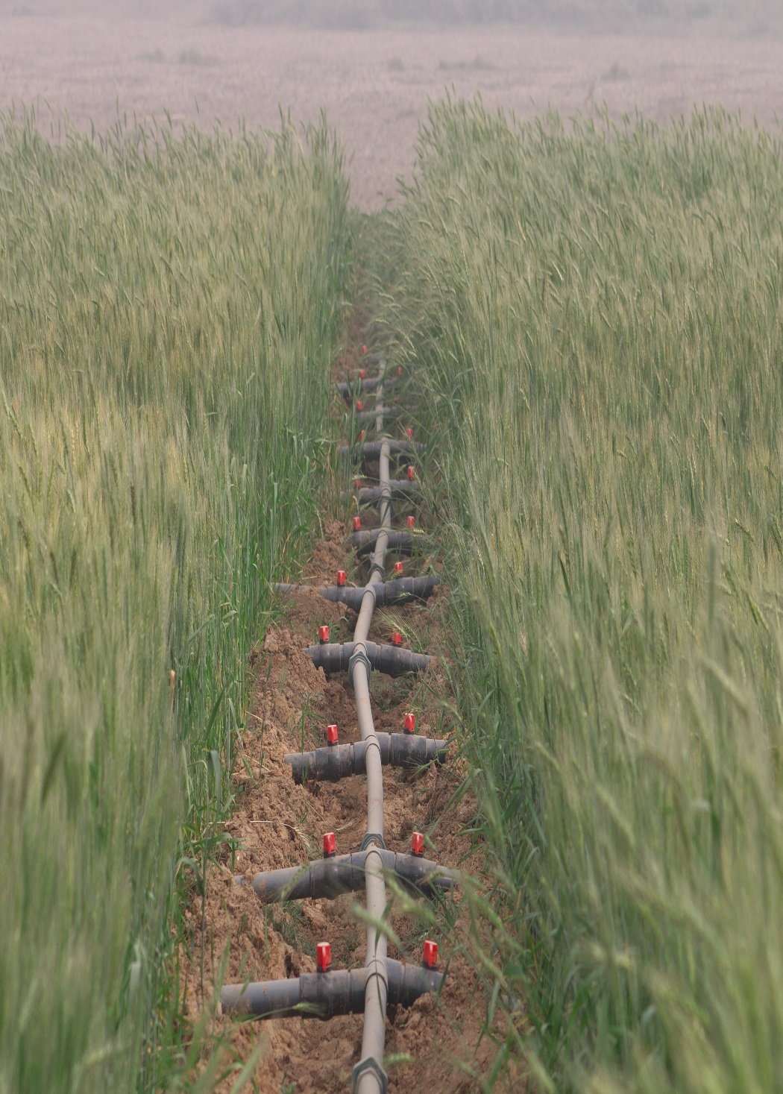
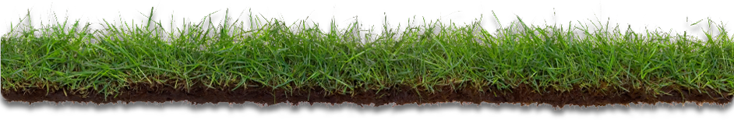
Agricultural transformation_1/2
Implies more efficient (in terms of resource use), inclusive, resilient & sustainable agricultural systems that safeguard the environment and lead to healthier soils, animals, and people
Must positively impact agric. productivity (closing yield gaps), that also translate into increases in profitability and farm income (when the surplus is marketed), avoiding exposing farmers to increased financial risk
Must guaranty increases in crop/livestock diversity, food & nutrition security, poverty reduce, & positively affecting human health (Bernstein et al., 2019; Gollin et al., 2018)
Public Lecture, UNN 4 August. 2021

Slide 7
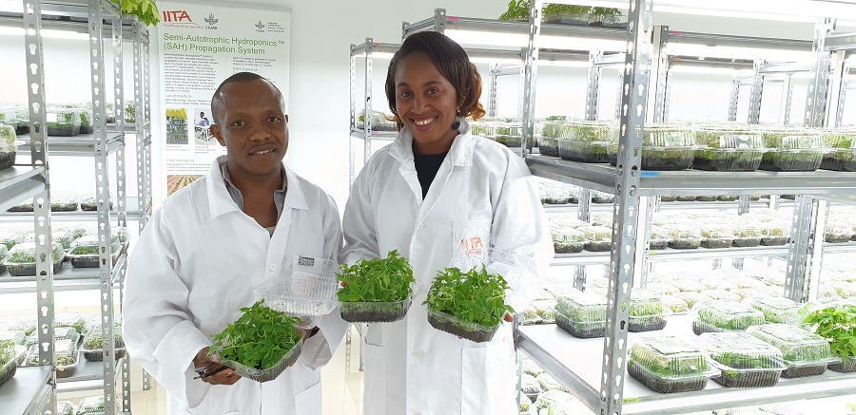
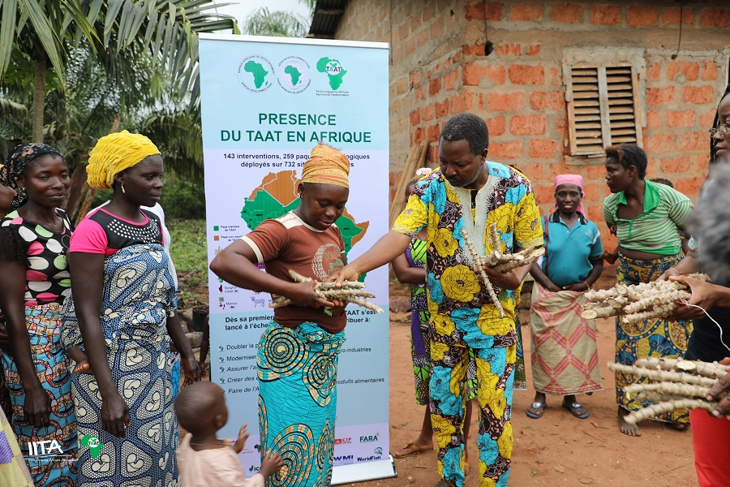
Agricultural transformation_2/2
Must move peasant & subsistence farmers to successful SMEs; raise living standards
Innovations get translated into actual benefits on the ground through reliable extension services
May involve hybridization of crops (e.g., rice, sorghum, millet, etc.) (supporting hybrid culture) to improve productivity & enhance private sector participation in input supply
Impactful technologies help in achieving agric. transformation (see later)
Public Lecture, UNN 4 August. 2021

Slide 8
Food systems transformation_1/2
This (not ag. transformation) is the focus now, expected to accelerate achievement of SDGs; is the target of the UN Food Systems Summit planned in September 2021
Sparked by prolonged economic growth, growing population, urbanization, shifting dietary habits (due to increasing middle class), innovation revolution in agriculture
Food systems (FS) encompass the entire range of actors & their interlinked value-adding activities involved in the production, aggregation, processing, value addition, marketing & commercialization, distribution, consumption, nutrition, infrastructure, & disposal of food products that originate from agriculture, forestry, or fisheries; includes the economic, social & environments they are embedded in.
Involve interactions among different interconnected sub-sectors (seen above), disciplines (economists, civil society organization workers, and practitioners in other disciplines and institutions), and elements (prices & markets, etc.); all must be understood to understand the FSs
Public Lecture, UNN 4 August. 2021

Slide 9
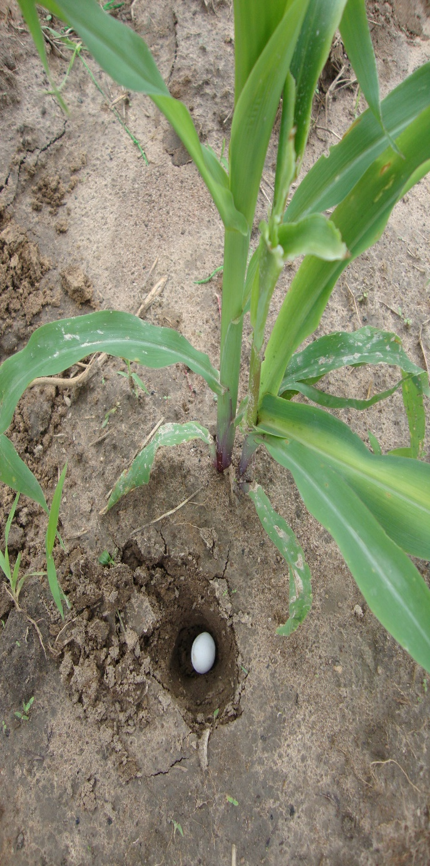
Food systems transformation_2/2
In FSs approach, innovations at scale should be regarded as part of a package or combination of core innovation (product, technology, or practice) with complementary innovations (delivery channels, etc.), helping create successful scaling conditions
Numerous issues are important & are driving FSs change: Prices & markets, how food supply interacts with a demand under the influence of policies and programs, environmental change, and technological innovation; Shocks significantly impact the FSs & often require policy responses to address
In FSs, target is to sustainably provide nutritious food for the growing population and for the food producers and workers in the food value chain to be adequately rewarded for their work, so that they do not themselves become vulnerable to hunger
For FSs to be sustainable, they must create decent livelihoods for rural people who get their income from farming, food processing, transport, manufacturing, and retail, including women, youth, and vulnerable groups
Public Lecture, UNN 4 August. 2021

Slide 10
Food systems in Nigeria: how to ensure sustainable transformation_1/2
Increased investment in targeted R&D for the transformation of the FSs and in relevant and supportive policy options
Investment in strong vocational training & skills development at scale as well as in integrating the concept of FSs into teaching and curricula; crucial to harness Nigeria’s youth dividend and ensure the next generation of Nigerian researchers has deep understanding of what constitutes the FSs
Investment in new technologies (ICTs, e-services, digital innovations, biotechnology, etc.) that facilitate the transformation of FSs
Need for all contributing disciplines to work together & be accountable, especially given the quality standards required
Public Lecture, UNN 4 August. 2021

Slide 11
Food systems in Nigeria: how to ensure sustainable transformation_2/2
Understanding how cities and their FSs connect & the complex/linked challenges among FSs, urban governance, & development, especially given that a city is what it eats
Understanding that the urban FS encompasses production, processing & packaging, distribution (transport, etc.), retail systems, consumption, and wastes – activities that affect access to food, food security & people’s lives, environmental security, & other societal interests
Dramatic changes in cities & FSs means that understanding how the rapidly urbanizing populations will be fed & fed well will be one of the critical development challenges of the next 50 years
Public Lecture, UNN 4 August. 2021

Slide 12
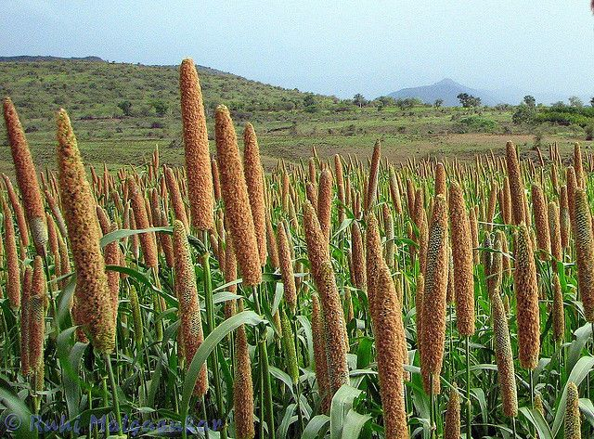
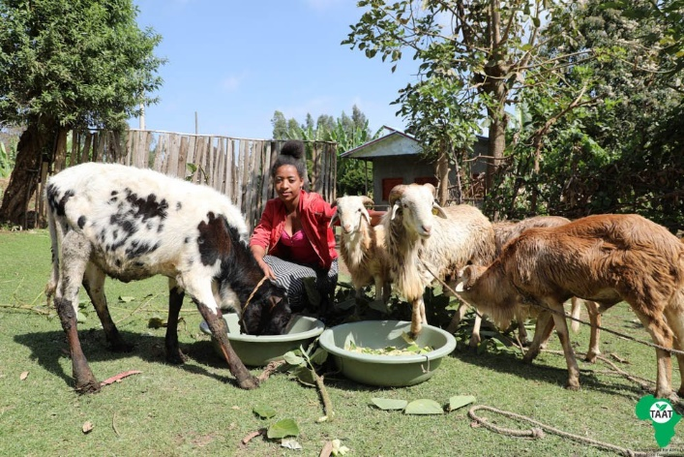
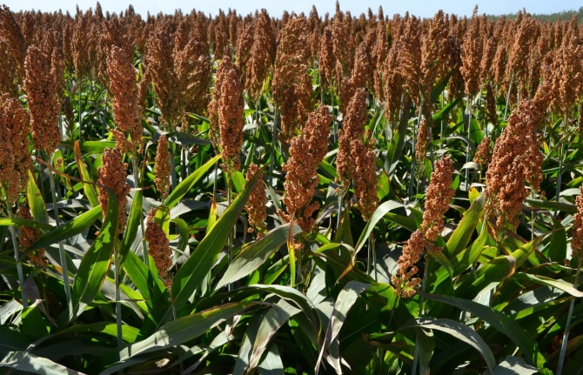
Why agricultural and food systems transformation are important to Nigeria_1/2
To forestall the rampant low productivity of major crops and increase the competitiveness of its agriculture through better access to technologies and innovations by small farmers, increased investments in food systems in line with the Malabo declaration
Production of enough food calories (presently being imported) to feed its rapidly growing population (3.2% p.a. according Nigerian Population Commission), especially important during food trade blockages and restrictions (as caused by the COVID-19 pandemic)
Nigeria’s GDP per capita has been declining every year, with GDP growth since 2015 less than population growth
Public Lecture, UNN 4 August. 2021

Slide 13
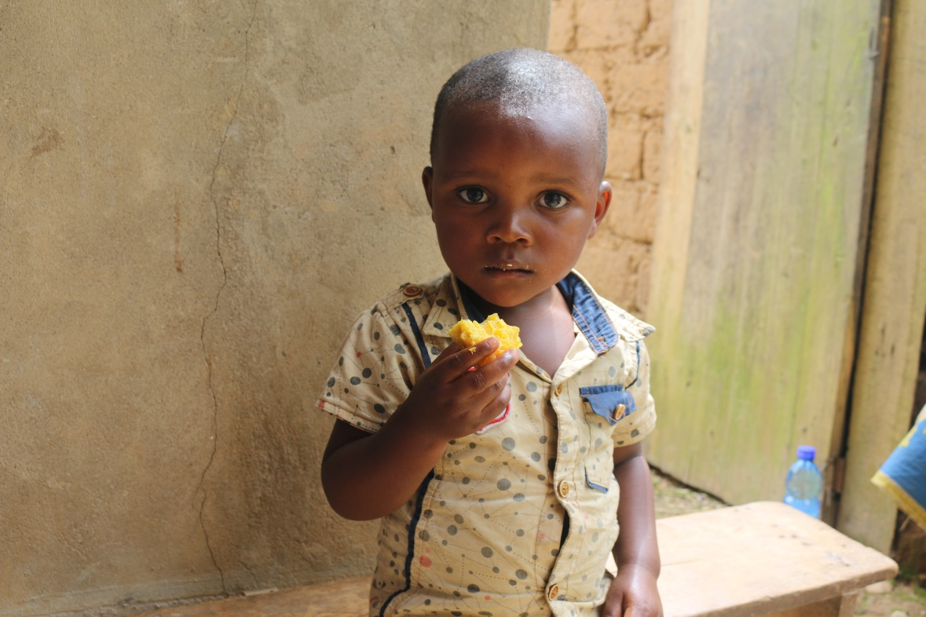
Why agricultural and food systems transformation are important to Nigeria_2/2
Nigeria is in the map of acute food insecurity hotspots (with 15 other African countries: 24 countries across the World) – March to July 2021 outlook by WFP & FAO; has the most people of any country in absolute poverty, ~ 100 million
Respond to the glaring interest in food quality, food safety, nutrition, health, and added concern for environmental dimensions of food production & consumption
Growth in agriculture sector is at least twice as effective at reducing poverty than growth in any other sector
Public Lecture, UNN 4 August. 2021

Slide 14
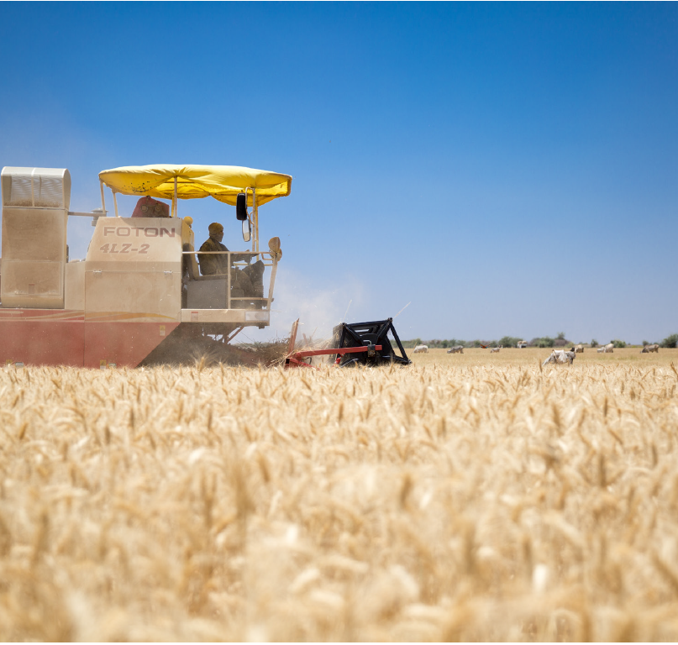
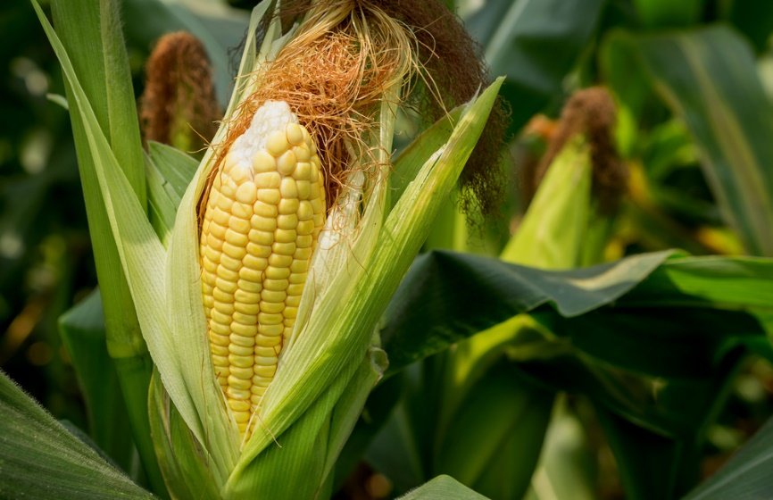
How technologies contribute to agricultural transformation_1/1
Green Revolutions of the of Latin America and Asia_Dwarf Wheat, etc.
Closed-system farming_Tomato productivity (in Spain): increases yield from 4 kg/square meter (open field conditions) to 80 kg/square meter, or 20 X more (done with 4 times less water & fully under biological control, meaning producing more using less inputs)
Wheat varieties in Sudan and Ethiopia_Heat tolerant varieties
Maize in East & Southern Africa_Water Efficient Maize for Africa (WEMA)
Public Lecture, UNN 4 August. 2021

Slide 15
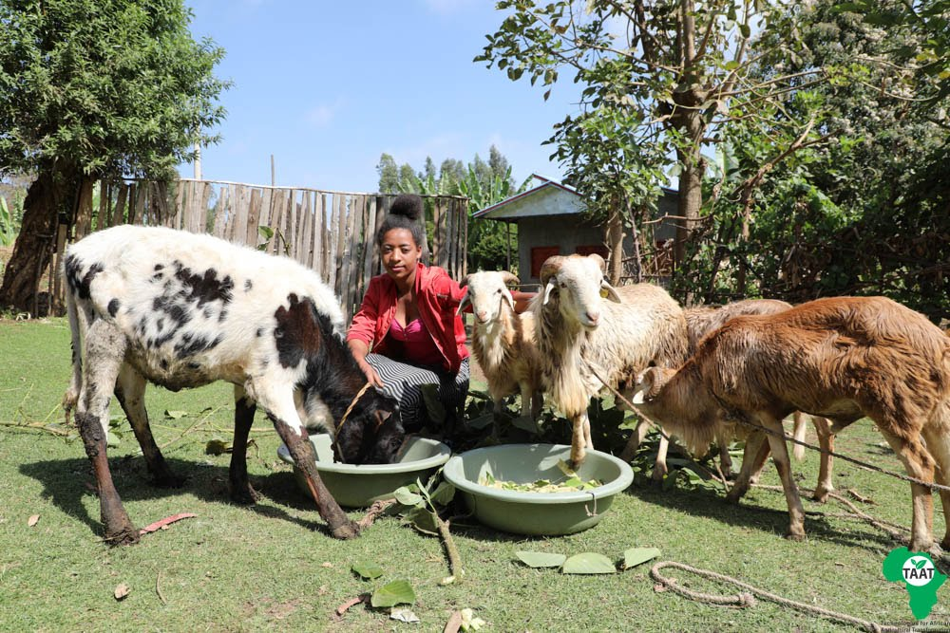
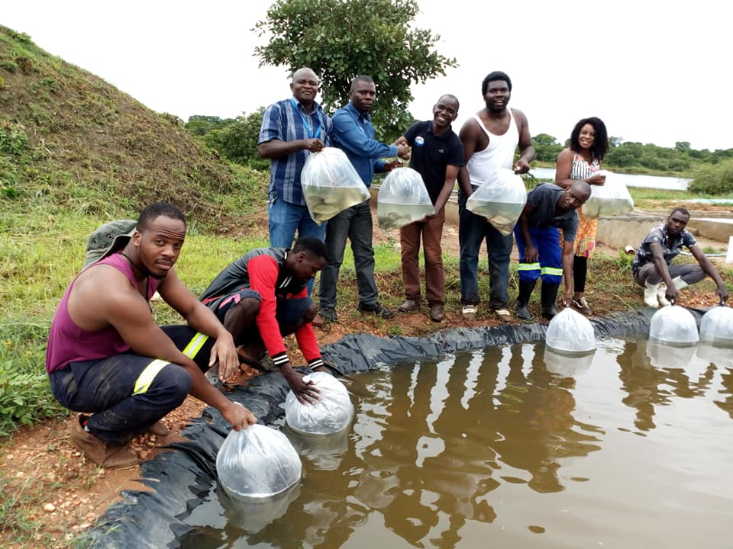
Impactful technologies that can lead to agricultural transformation in Nigeria_1/2
These are found in all areas of agriculture: Crops, Livestock, Aquaculture, Soil, Irrigation, Nutrition, Irrigation and index insurance, Mechanization, Etc.
  Crops: Improved varieties (climate-smart, pest and disease resistant, drought tolerant, etc.)
  Livestock: Improved breeds (climate-smart: for meat, milk, production of less gasses during digestion); highly nutritious fodder; etc.
  Aquaculture: Improved fingerlings (climate-smart, low C emission), processing technologies, etc.
  Soil: Soil Health Innovations (ISFM), Soil testing for appropriate soil management decisions, sustainable agriculture & productivity growth, overall soil health, efficient manure management system, etc.
Public Lecture, UNN 4 August. 2021

Slide 16
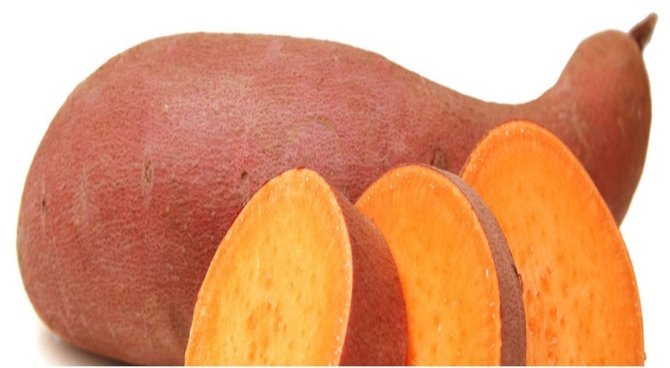
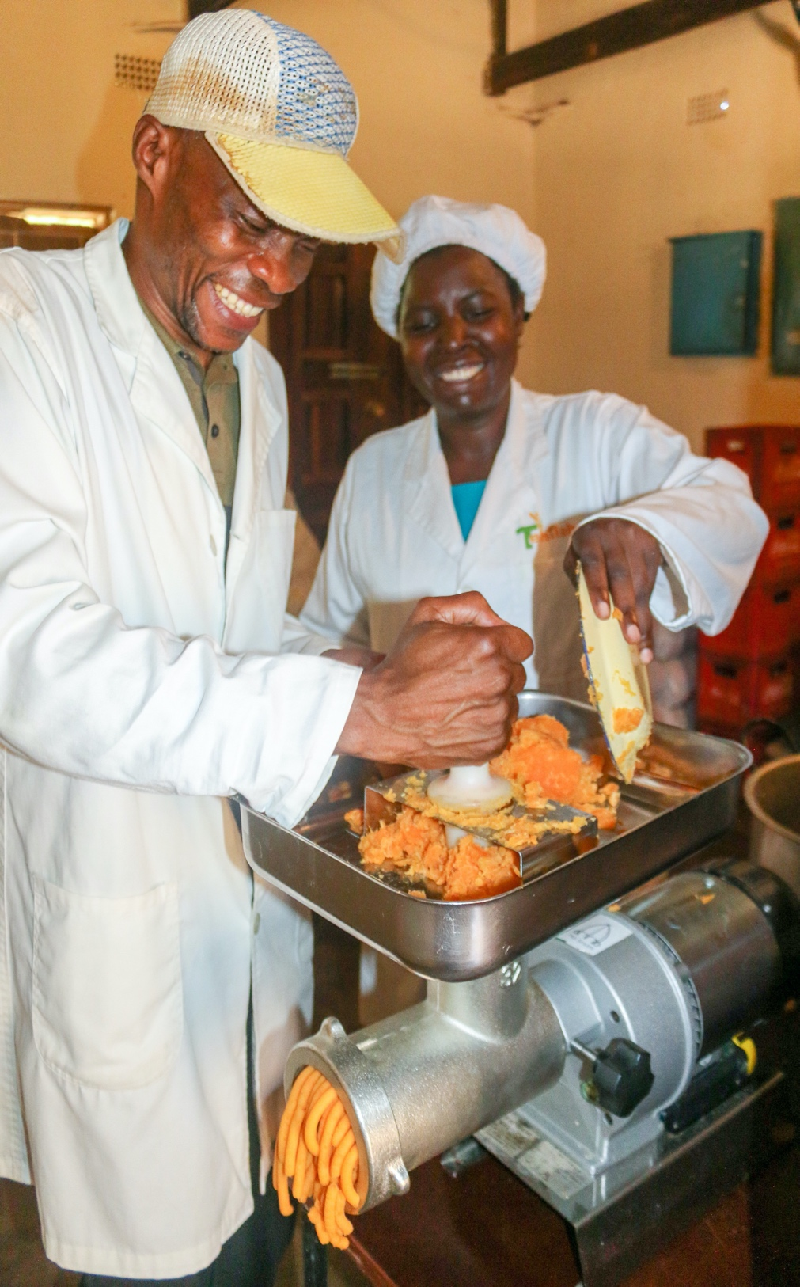
Impactful technologies that can lead to agricultural transformation in Nigeria_2/2
These are found in all areas of agriculture: Crops, Livestock, Aquaculture, Soil, Irrigation, Nutrition, Irrigation and index insurance, Mechanization, Etc.
  Efficient small-scale irrigation (shallow tube wells, washbowls & other water management technologies) for lifting water: Improved productivity, better market
  Nutrition: Biofortification, use of digital communication to reinforce nutrition & household resilience, etc.
  Irrigation and index insurance: Innovations that expand farmers’ overall drought protection, unlock investments that leverage the benefits of irrigation, better managed risks, etc.
  Mechanization: Rate still too low in Nigeria (like most African countries) - hoe/cutlass technology is still dominant
Public Lecture, UNN 4 August. 2021

Slide 17
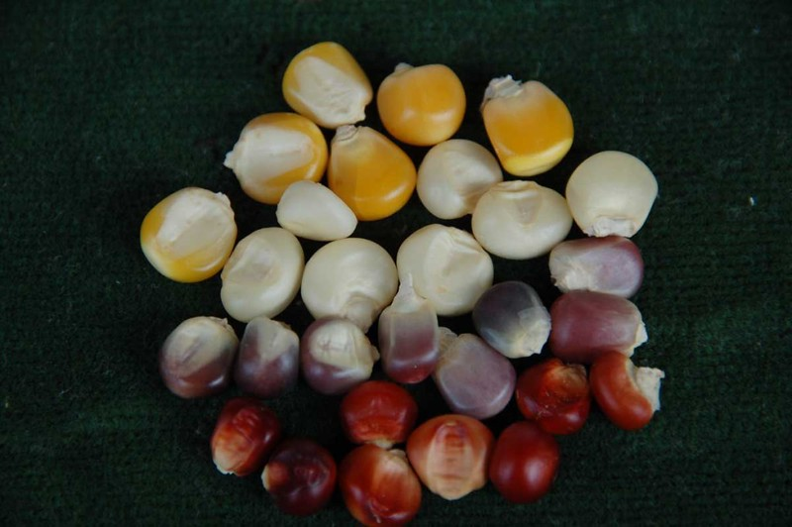
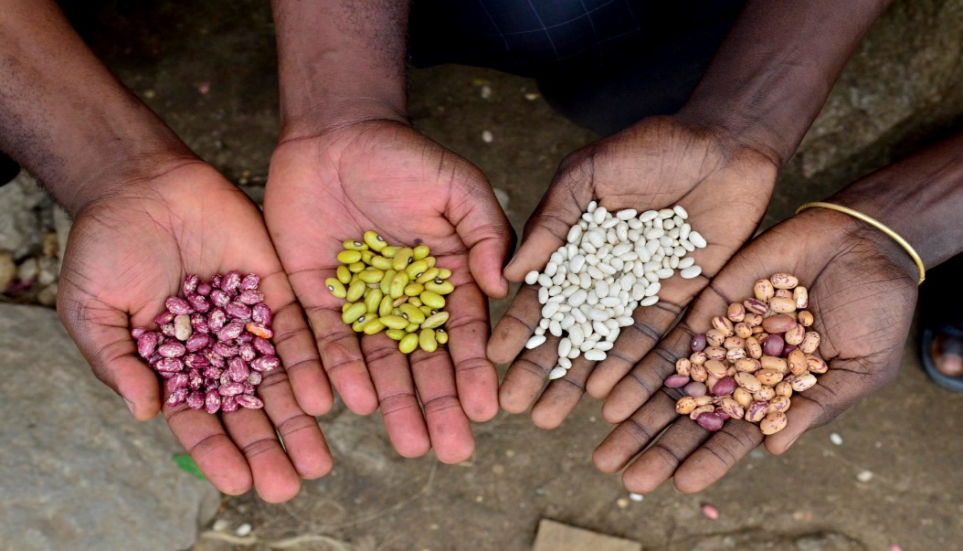
Available technologies & innovations that can significantly contribute to agricultural transformation_1/1
Climate smart agricultural technologies (seeds, breeds, fingerlings, etc.) - help farmers to build resilience in the face of climate change
Digital technologies/digital agriculture (weather advisory, etc.)
Soil health innovations & technologies
Integrated Soil Fertility Management (ISFM) & Agronomic Efficiency
Sustainable intensification
Biofortification/Fortification (breeding of nutrient dense crops, etc.)
Innovation Platform or Multi-stakeholder Platform
➔ Deep dive in next slides
Public Lecture, UNN 4 August. 2021

Slide 18
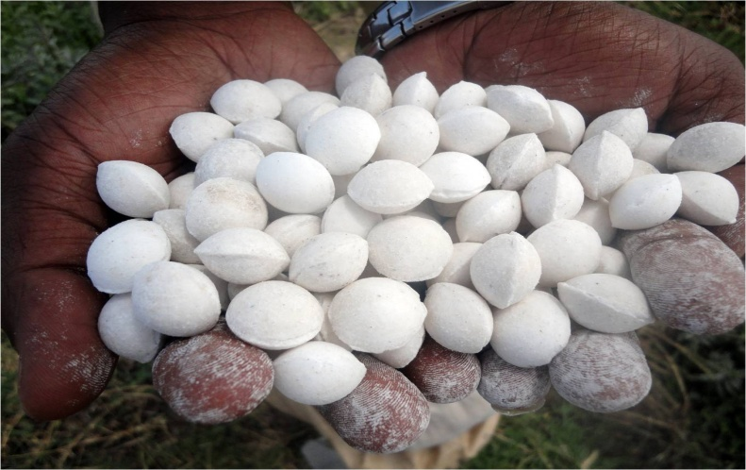
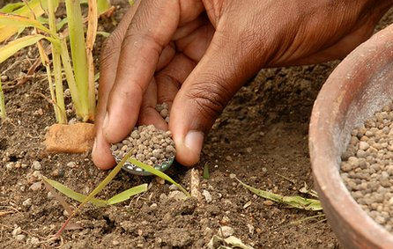
Climate smart agricultural technologies – Deep Dive_1/12
Help reduce weather volatility & climate related risks (esp. in the absence of insurance services): Examples include heat tolerant varieties, improved agronomic practices, etc.
Help to address the negative impact of recurrent droughts. Examples include innovations related to planting of cover crops, covering of topsoil to prevent or limit heat transfer to the soil & protect compost from washing off easily
Public Lecture, UNN 4 August. 2021

Slide 19

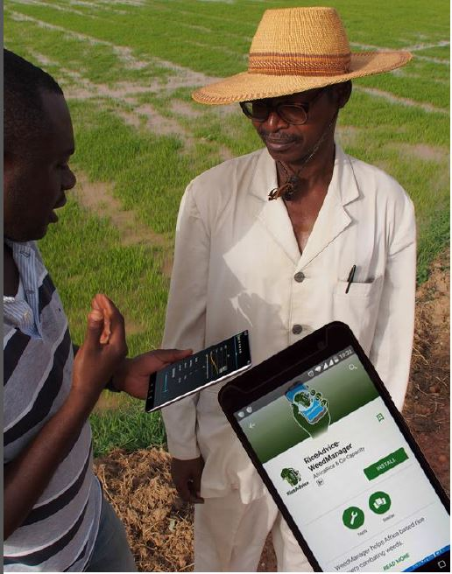
Digital technologies/agriculture – Deep Dive_2/12
Digital tools and infrastructure are used to multiply impact exponentially
Develop farmers’ database – a register through which farmers can be categorized (e.g., by commodities) for intervention targeting
Support advisory services, service delivery, farm level solutions (e.g., precision agriculture), access to markets & finance (farmers & aggregators), supply chains & distribution systems (digital info can mitigate many challenges facing supply chains) – thereby improving farmer livelihoods & profitability of agri-enterprises
Make a significant contribution to pests/diseases surveillance & effective management/ response
Public Lecture, UNN 4 August. 2021

Slide 20
Digital technologies/agriculture – Deep Dive_3/12
Support the growing & marketing of crops (mostly by aggregators, processors, and exporters to collect & analyze data)
Enables real-time & effective collection of orders by suppliers & payment by the SHFs with minimum travel & transactional costs, especially when roads are bad – Improves SHFs’ bargaining power and the rural economy
Help in technology transfer, knowledge management, input & output marketing, stakeholder networking, improving food fortification quality & compliance, etc.
NB – Smallholder farmer engagement with digital tools is low, <10% due to lack of digital literacy/engagement
Public Lecture, UNN 4 August. 2021

Slide 21
Soil health innovations & technologies – Deep Dive_4/12
Foster healthier soils that benefit farmers and the environment, esp. as drought/flood become more frequent
Soil is healthy if it is continuously able to function as a vital living ecosystem to sustain plants, animals, and humans as well as can store more carbon (taken in by plants as CO2, returned to soil when plants die) that helps release the required nutrients for plant growth & improve soil structure
Efficient soil management is a useful buffer against weather extremes due to global warming. Achieved through planting of cover crops, reducing tillage & soil compaction, improved crop rotation, use of compost, covering of topsoil with wood chips or straw to prevent or limit heat transfer to the soil & protect compost from washing off easily
Public Lecture, UNN 4 August. 2021

Slide 22
ISFM: Trajectory & effect on agronomic efficiency– Deep Dive_5/12
Full ISFM combines germplasm & fertilizer, organic resources management, & local adaptation (e.g., micro-dose fertilizer application 4 kg P/ha, not 13 kg P/ha recommended; targeted fertilizers that could contain secondary and micronutrients like Zn, S, etc.; smart fertilizer blends) (see next slide)
It is easily described as climate-smart and leads to increases in productivity, soil C stocks, and yield stability
It follows similar arguments in the 2nd paradigm but acknowledges that the most adoptable organic inputs or resources are those produced in-situ through improved crop yields or integration of grain legumes with low-harvest indices
Acknowledges need for inorganic fertilizer but again emphasizing organic inputs
Public Lecture, UNN 4 August. 2021

Slide 23
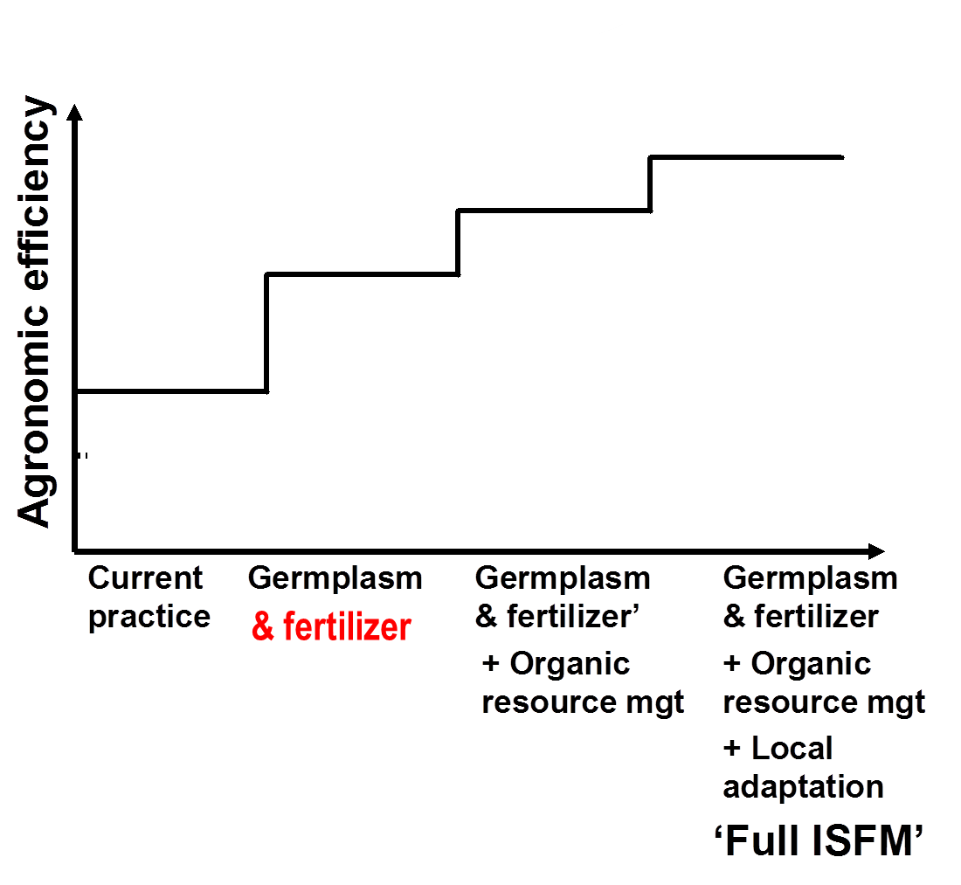
ISFM: Trajectory & effect on agronomic efficiency– Deep Dive_6/12
Public Lecture, UNN 4 August. 2021

Slide 24
Integrated Soil Fertility Management (ISFM) – Deep Dive_7/12
Many of its components contain a water-related dimension:
  Variety can include drought-tolerance or early maturity to escape mid-season drought, deep-rooting, etc.
  Organic input contribute to enhance soil cover & increased soil C stocks, thus positively affecting the soil moisture balance
  Local adaptation can include options for in-situ water harvesting (e.g., through water-harvesting technologies - zai systems) and allows for application of tillage as required by local soil conditions or crop characteristics (e.g., root crops often do require some loosening of the topsoil, esp. heavy soils). Explains why ISFM is not explicit about tillage & mulch application since there are situations where some form of tillage is beneficial (to remove soil crusts). Leaving crop residues as mulch cannot happen if the soil requires some tillage
Public Lecture, UNN 4 August. 2021

Slide 25
Sustainable intensification (SI) – Deep Dive_8/12
Built on four guiding principles (adapted from Society 2009, Vanlauwe et al., 2014): increased & maximized production or output per unit of resource (land, labor, capital, etc.) used; Preservation of ecosystems and soils; Increased resilience of farming systems to shocks and stress; Improved or maintained profitability at farm-level
Five (5) key attributes for SI: use of more productive crops & varieties, judicious application of external inputs, harnessing of existing biological processes (where possible), minimization of adverse effects on the environment, and productive use of human capital
Public Lecture, UNN 4 August. 2021

Slide 26
Sustainable intensification – Deep Dive_9/12
Factors that are important for intensified agricultural production: Water management tools, Quality planting materials, Tools for pest & disease management, Soil fertility management, and Mechanization
NB: Old skills that make it difficult for farmers (especially women) to sustainably intensify their production must be unlearned.
Public Lecture, UNN 4 August. 2021

Slide 27
Biofortification/Fortification – Deep Dive_10/12
Biofortification is about breeding added nutritional values and impact into familiar foods that people eat everyday
Widely recognized as an approach to addressing micronutrient deficiency among low-resource populations
Spearheaded (starting in 2003) by IFPRI- and CIAT-managed Biofortification Challenge Program (renamed HarvestPlus)
Examples of available biofortified crops are iron bean, pearl millet, lentil, cowpea, and Irish potato; vitamin A cassava, maize, orange sweet potato, banana/plantain; zinc maize, rice, wheat, sorghum; Etc.
Public Lecture, UNN 4 August. 2021

Slide 28
Biofortification/Fortification – Deep Dive…_11/12
Fortified/Biofortified foods have a significant impact on improving the nutritional intakes and health of a population – however must meet government-issued standards related to quality & safety
Biotechnology can be used to enhance agricultural productivity for food security and nutrition in Nigeria
The development of continental guidelines for the use of Biotechnology to achieve increases in productivity in Africa is ongoing by the African Sees and Biotechnology Platform (ASBP) steering group members under the aegis of the African Union Commission (AUC)
Public Lecture, UNN 4 August. 2021

Slide 29
Innovation Platform or Multi-stakeholder Platform and What they do – Deep Dive_12/12
Innovation Platforms (IPs) bring about a business mode
Facilitate the linkages of farmers with a full complement of stakeholders for operation in a business mode
Establishing IPs will help government and private machinery operators determine the type and kind of machinery system to adopt for a particular location per commodity of cultivation and farming systems
Public Lecture, UNN 4 August. 2021

Slide 30
Technologies being pushed by World Powers: Reasons to be mindful of these_1/1
Organic farming or Organic agriculture – May limit Africa’s (+Nigeria) capacity to feed its growing population
Diversified agroecology farming – The building blocks (Knowledge, key diversities, appropriate mechanization, and market linkages) that will ensure that this system leads to higher productivity, income, resilience and more jobs still largely lack in Nigeria
Technology-intensive system – Africa (+Nigeria) lacks the resources and technical know-how to produce food using this
Public Lecture, UNN 4 August. 2021

Slide 31
Key contributors to agric. modernization in Nigeria_1/2
The Government – Enabling environment (policies, regulations, etc.; also, to incentivize the adoption of modern agric. technologies)
World Bank – Funding support, also through WAAPP)
African Development Bank – Funding support, through various programs: NERICA; SARD-SC; AFT; TAAT & Feed Africa strategy
Consultative Group on International Agricultural Research (CGIAR) Centers (e.g., IITA; AfricaRice; ICARDA; ICRISAT; ILRI, etc.) – R4D, GAPs
The UN Food and Agriculture Organization – R4D, TA, Policy, GAPs, Etc.
Public Lecture, UNN 4 August. 2021

Slide 32
Key contributors to agric. modernization in Nigeria_2/2
Alliance for a Green Revolution in Africa (AGRA) – Funding, Etc.
National Agricultural Research Systems (NARS) – R4D
Advanced Research Institutions (AATF, IFDC, FARA) – R4D, TA, Etc.
Academia – Functional education, Practical Knowledge, R4D, Etc.
The Private sector (Agrodealers, Seed Companies, etc.) – Sustainability (environmental, economic, & social), Jobs, Etc., capitalizing on the Enabling Environment
Public Lecture, UNN 4 August. 2021

Slide 33
Challenges Nigeria must come to terms with, trying to harness technologies for agricultural transformation_1/1
Climate change, variability & shocks: extreme weather conditions; more common vagaries of drought with longer periods; late, shorter, & erratic rains; more common floods due to heavy rains; increasingly fluctuating inter- and intra-seasonal rainfall distribution; irregular seasonal patterns
Natural resources challenges: environmental degradation, increasing resource scarcity
Socioeconomic shocks: rising fragility, armed conflicts & civil strife, economic crises, global health crises such as COVID-19 pandemic, inequity, etc.
Human challenges: changing dietary patterns, population growth
Crop & livestock diseases and pests: Fall Armyworm, locust invasion
Public Lecture, UNN 4 August. 2021

Slide 34
Way forward: What does Nigeria need to do right?_1/2
Nigeria needs to do many things right: A select few below
Economic diversification
Manufacturing: value addition and processing
Stop stifling innovations & unfriendliness with smart money: through rent mentality, other non-tariff barriers, low ranking in the ease of doing business
Prioritize improvement of infrastructure and market access: key enablers for food and nutrition security and better livelihoods
Public Lecture, UNN 4 August. 2021

Slide 35
Way forward: What does Nigeria need to do right?..._2/2
Nigeria needs to do many things right. A select few…
Deal with insecurity, religious strife, unfavorable regulatory and legal environment, unstable macroeconomic policies, high inflation
Uphold the principles of subsidiarity: deal with issues at the most local level at which they can be addressed (not remaining reluctant to devolve to local governments)
Take advantage of the market opportunities & economies of scale provided by the AfCFTA & tap the great potential in its youths
Cultivate character: of truth, honesty, trust, etc. (needed to transform a nation)
Public Lecture, UNN 4 August. 2021

Slide 36
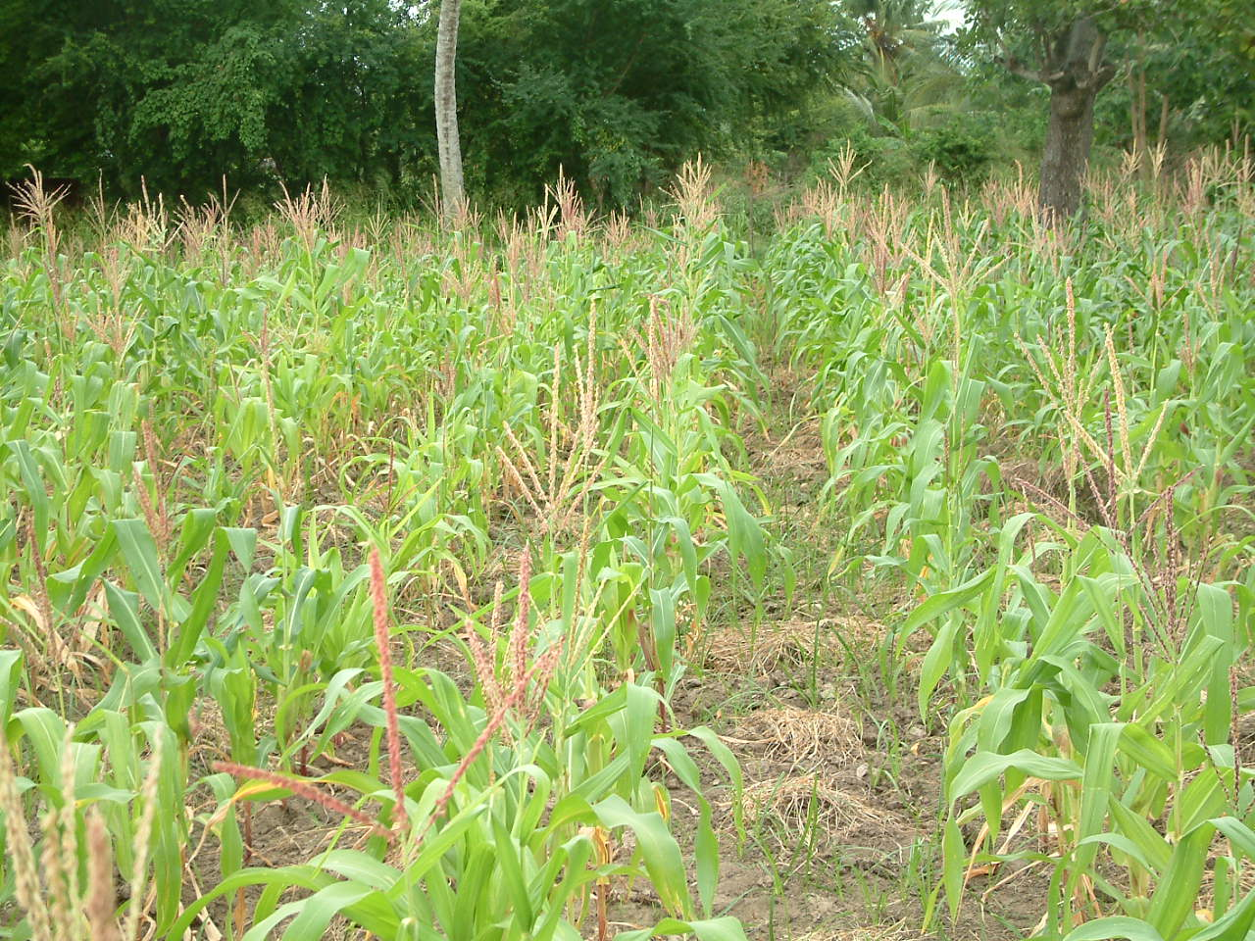
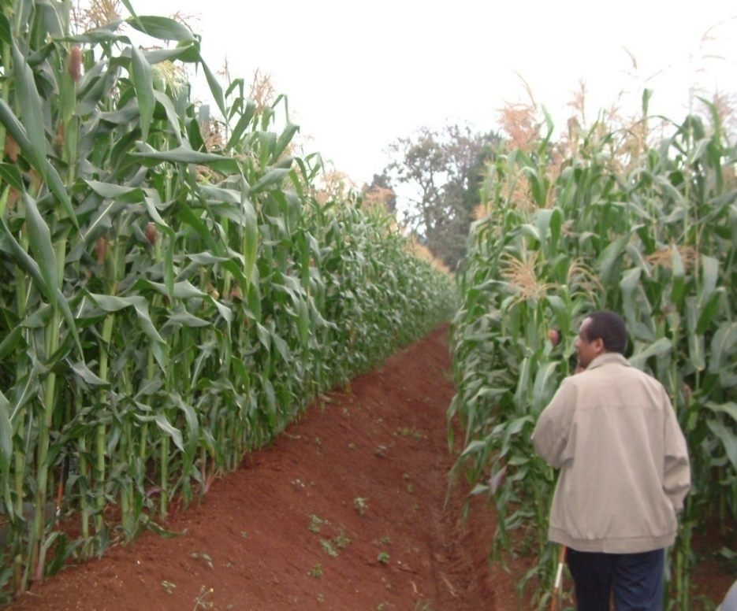
Conclusion
Harnessing available technologies and innovations for Agricultural Transformation holds promise for Nigeria if the mindset is changed by all stakeholders and the right pre-conditions are set
Thank you very much for listening
Public Lecture, UNN 4 August. 2021

